Slide 1


Golf Score Tracker with C
By Maitreya, Manas and Manish

Slide 2


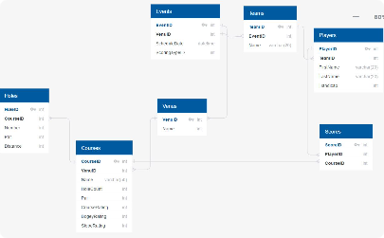
The Foundation: Tracking Rounds Played
Structured Data
User Input
Data Tracking
Store the number of rounds played in an array, allowing us to easily access and manipulate this information.
Prompt the user to enter the number of rounds, ensuring accurate data representation and fostering a dynamic experience.
Holds and displays data of each player, including total score and average score

Slide 3

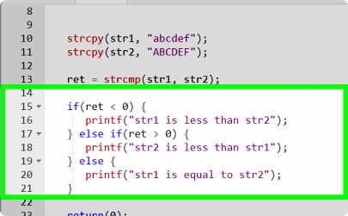
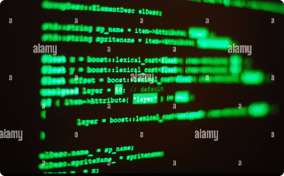
Features
Multiple Players
Data Manipulation
Efficient Storage
We use multidimensional arrays to handle the scores and data for all four players with ease and efficiency.
Adds the players scores for 5 holes, hold those values and use them to display them later, along with their averages. Also used to find additional info of the players as a group (total score, total averages etc)
By utilizing arrays such as 'Player', 'hole', 'HoleScore' etc to store the data, we conserve memory and streamline access, ensuring optimal performance as well as ease while changing something later.

Slide 4

Score Tracking: Totals and Averages
Total Score
Assign individual arrays to store the total score for each player, allowing for detailed analysis of performance.
Calculating Averages
Use the total score and the number of rounds played to calculate the average score for each player, providing valuable insights.

Slide 5
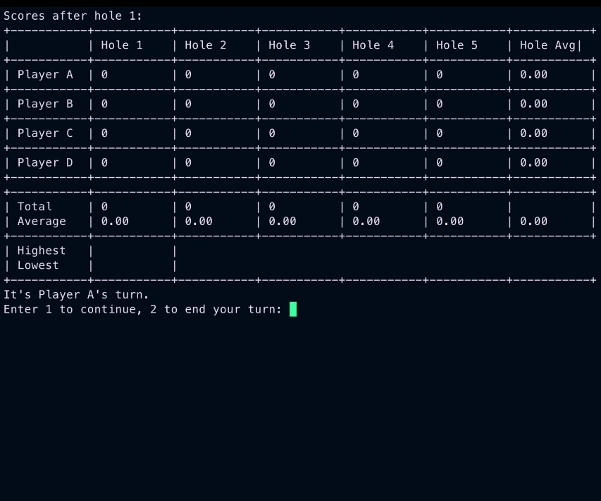
Input and Output
this is the entry page, the scores initialize at 0.

Slide 6
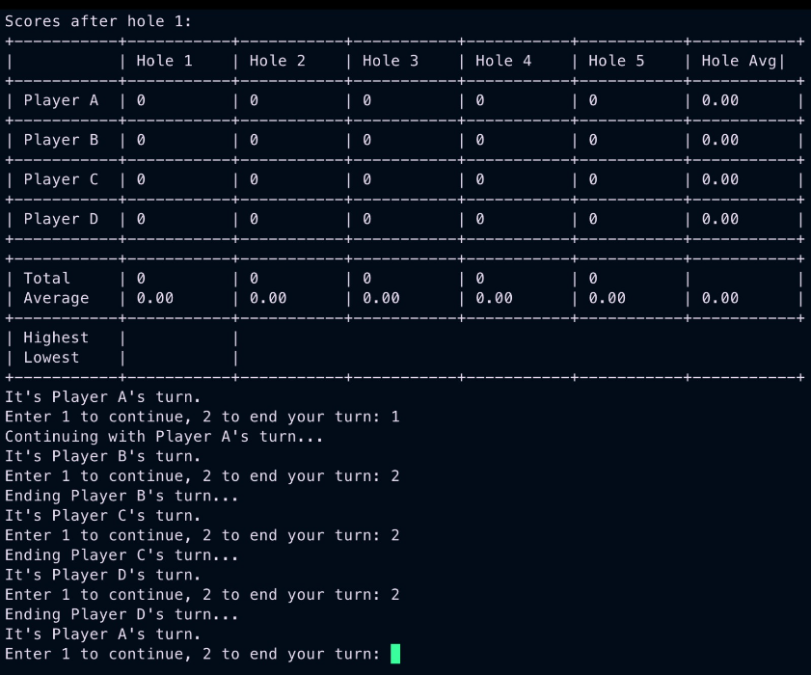
Input and Output
Taking inputs for the first hole

Slide 7
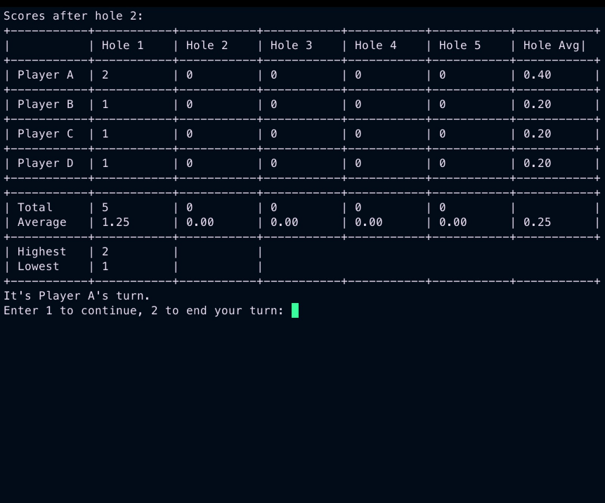
Input and Output
At the end of hole 1, score is updated and the game moves on to the next hole

Slide 8
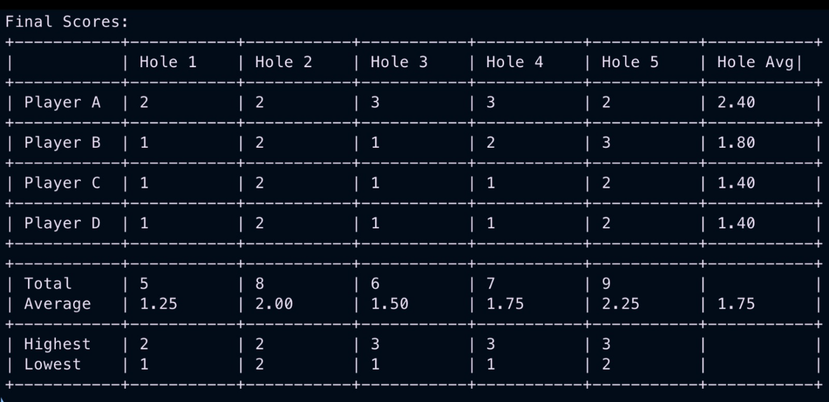
Input and Output
Final Output at the end of 5 holes

